Slide 1
Amusement park Safety
Peter Nguyen
Margarita Martinez
Chris Richardson
Travis Genovese

Slide 2
Background
The purpose of this project is to find the relationship between injuries and Amusement parks.
Questions
  What type of ride has the most accidents?
  What age group is more susceptible to injuries?
  What is the most common type of injury?
  What state had to most injuries from Amusement parks.

Slide 3
Hypothesis
Coasters are believed to have the highest injury rates of Amusement Parks
Ages 12 and under would likely have the highest injuries in Amusement parks
Whiplash is most likely the highest cause of injuries of all the rides
California will have one of the highest injury rates

Slide 4



Data Clean up
Found data on saferparks.org
Clean up data by categorizing ride type, age group, injury severity.

Slide 5
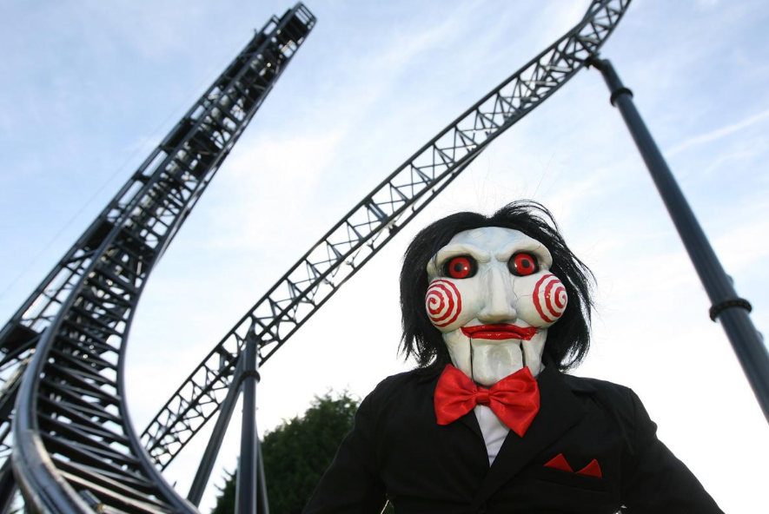
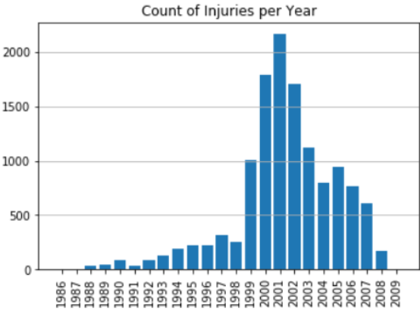

Slide 6

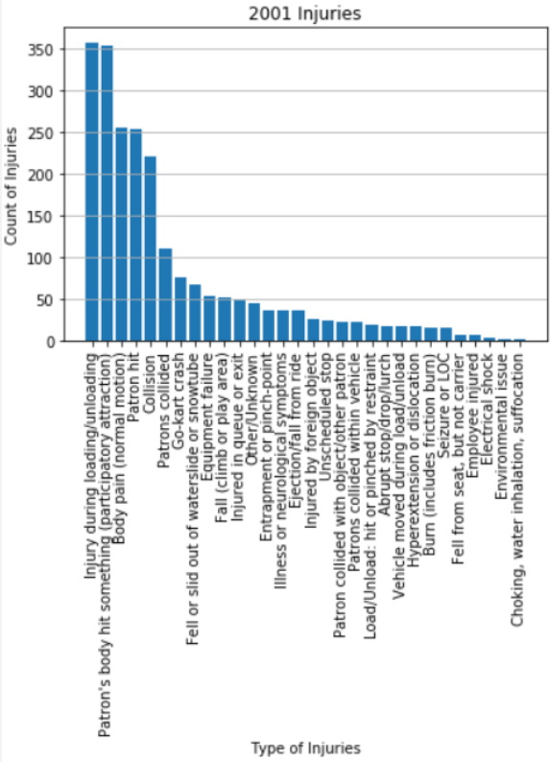
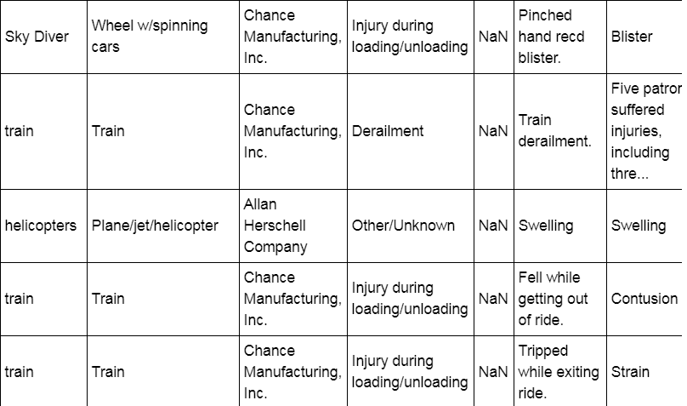

Slide 7
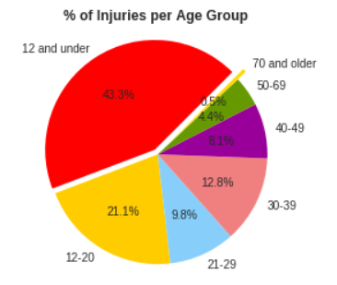
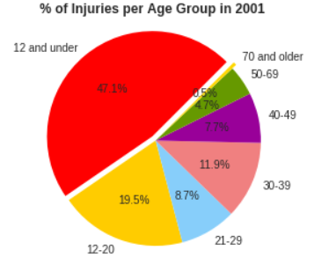

Slide 8
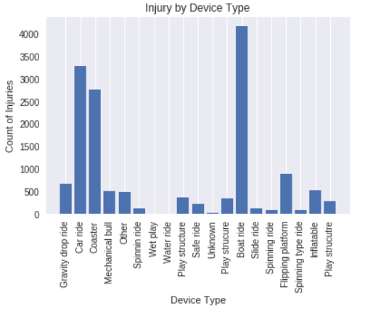
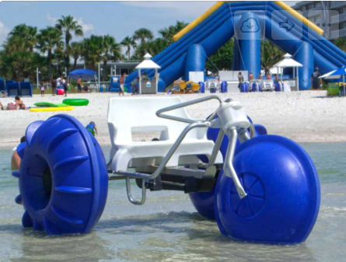
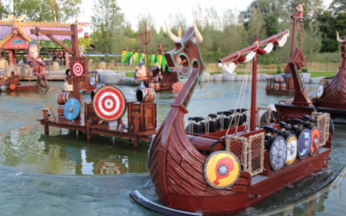

Slide 9
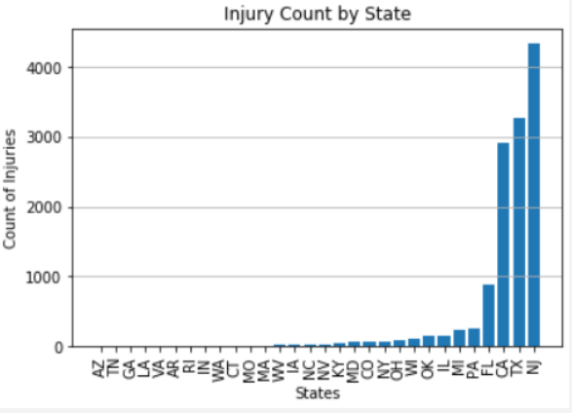
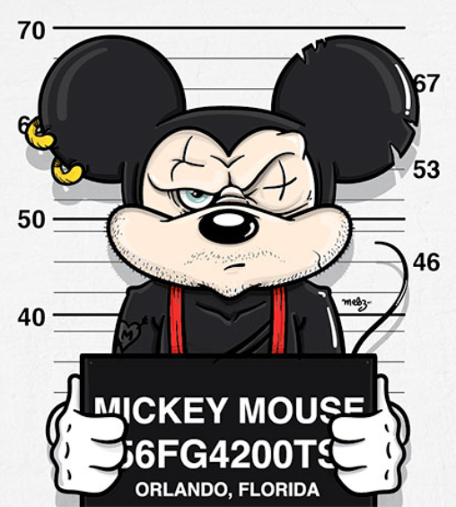

Slide 10
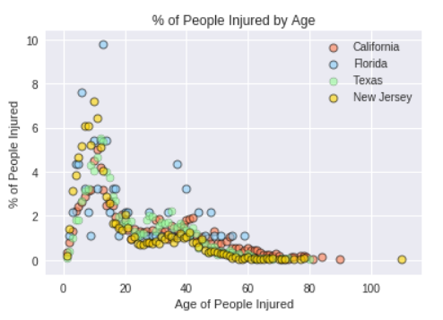
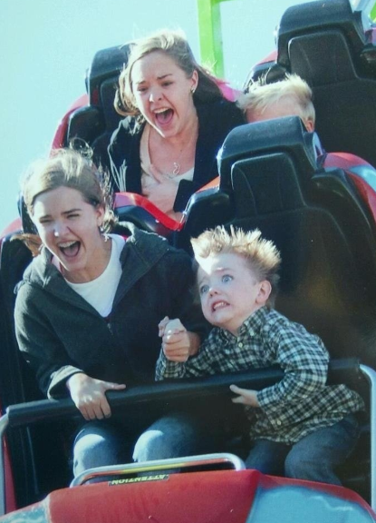

Slide 11
Conclusion
Boat rides had the highest injury rates of all the rides
People below the age of 12 had the highest percentage of injuries
Loading and unloading from rides caused the most injuries
New Jersey is the state with the most injuries

Slide 12
Limitations
This data varies widely in content and consistency
States with stronger government oversight will tend to produce more accident reports
There is no standardized reporting system for injuries at amusement parks nation wide
The number of accident reports in a category depend on many variables unrelated to rider safety
Causation does not equal correlation

Slide 13
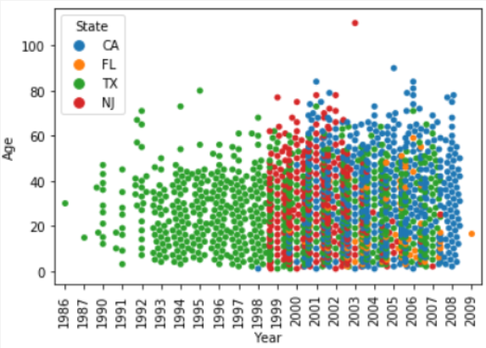
Limitation

